Slide 1
GradeIt
Jose Urdaneta
https://github.com/urdans

Slide 2
Description
Overview:
Web site for small to medium schools for the administration and control of evaluation plans and student grading.
This web application allows teachers to entry, save, modify and review the evaluation schedules for their assigned subjects and to grade the students according to the evaluation plans.
Students are able to see their grades using this web app.
A special user, the registrar, is able to entry data about hired teachers and to make the enrollment of students.
Goals:
The main goal for the development of this web application was to gain new knowledge about several technologies and plunge deeper in the Spring Boot framework.

Slide 3
Features
There are (3) different kinds of users: students, teachers and registrars.
There is a user registration to the web site (except for registrars who are registered by the web app administrator).
Data visualization for students.
Data entry and visualization for teachers and registrars.
It’s a basic CRUD web application with a thin layer of business rules hard coded in the app itself.

Slide 4
Planning - User Stories
- When a user logs into the web app and depending on the type of user (his role: student, teacher or registrar) the site will display different pages.
- A student logs in and is able to see his grades for the subjects being attending.
- A teacher logs in and can enter the evaluation schedule for each of the subject he teaches.
- A registrar logs in and is able to hire the teachers, enroll the students, pair the teachers with the subjects and create the groups

Slide 5
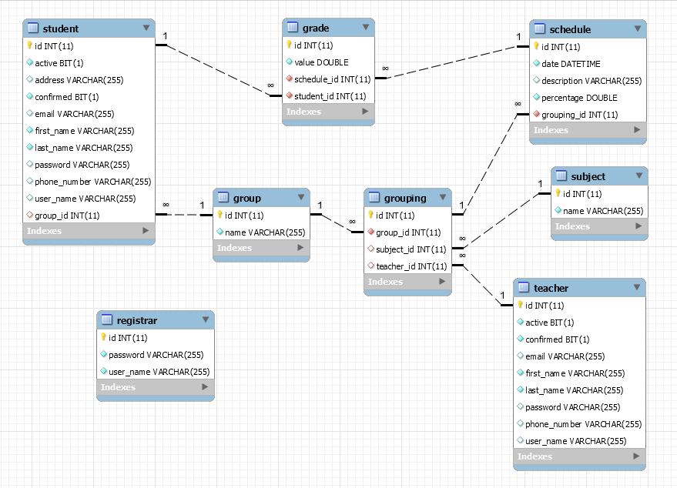
Planning - Database

Slide 6
Technology Stack
Java
Spring Boot
Thymeleaf
MySQL
JavaScript
HTML, CSS
MySQL Workbench, IntelliJ, VSCode
Git, GitHub, Stack Overflow, W3Schools, Baeldung and 100 more…

Slide 7
Demo

Slide 8
What I Learned
I got a deeper understanding of the Spring Boot framework, JPA and Thymeleaf.
I learned vanilla JavaScript and the DOM.
How to write REST API and how to call them from the client side using JavaScript and JSON

Slide 9
What’s Next
Replace the actual pure Java HttpServletRequest and HttpSession objects to manage sessions with Spring Security.
Add email validation by sending an email with keys and tokens to the user.
Reduce the JavaScript boilerplate by using JQuery or maybe React frameworks
Notes:
Be specific! If you mention another feature describe why that features is necessary, or what problem it solves. If you mention changing the UI mention specific technologies, or libraries you will use to do that. If you mention a technology, or feature you don’t know yet tell them how you plan on learning it.

